Slide 1
Deep Learning Transliteration Model
A sophisticated sequence-to-sequence architecture built with PyTorch, designed for multilingual transliteration with attention mechanisms and beam search decoding.

Slide 2
Modular Design and Architecture
Scalable Structure
Real-World Architecture
Experimentation Ready
Every major function—data loading, preprocessing, training, evaluation, and inference—is encapsulated in its own block, making the system scalable and debug-friendly.
The code is organised around classes and helper functions (Encoder, Decoder, Attention, Dataset) that mirror professional deep learning project architecture.
Instead of monolithic scripts, this modular approach enables rapid experimentation with multiple languages and architectural variations.

Slide 3
Data Management & Preprocessing
Multilingual Dataset Handling
Smart Preprocessing
The system intelligently navigates through multiple language folders—Hindi, Tamil, Bengali, and more—treating them as a unified multilingual dataset.
Text cleaning, character normalisation, and language tagging happen automatically. A language tag is attached before every word, adding slight computational overhead but enabling zero-shot generalisation.
Each language maintains separate train/validation/test files whilst sharing common preprocessing logic.
This allows the model to transliterate unseen languages if they share character similarities.

Slide 4

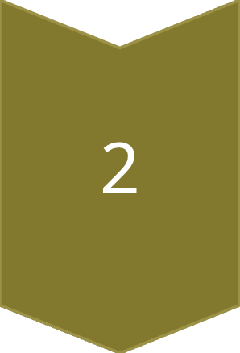
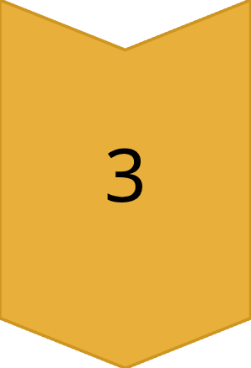
Vocabulary Building & Tokenization
Character-Level Mapping
Vocabulary creation runs across all datasets, building character-level mappings. Each unique character gets converted into an integer index.
Dictionary Creation
The system creates a dictionary of thousands of symbols across scripts. Special tokens (<SOS>, <EOS>, <PAD>, <UNK>) are reserved for sequence control.
Dynamic Encoding
Large lookup tables encode/decode strings dynamically for every mini-batch during training, ensuring the model understands text as sequences of signals.

Slide 5
Dataset Engineering & Efficient Batching
1
2
3
Custom Dataset Class
Dynamic Padding
Parallel Processing
TransliterationDataset handles individual word pairs and converts them into tensor sequences automatically.
A collate function merges samples into uniform batches by dynamically padding sequences to match the longest sample—balancing memory efficiency and processing speed.
PyTorch DataLoader enables multi-threaded parallelism, ensuring the GPU remains fully utilised even with large datasets.

Slide 6



Core Architecture: Encoder, Decoder & Attention
Attention Mechanism
Computes alignment scores at each decoding step—deciding which characters of the input to focus on for accurate transliteration.
Bidirectional Encoder
Uses Bidirectional LSTM to read Romanised text in both directions, extracting contextual meaning from the input sequence.
Sequential Decoder
Another LSTM that uses context vectors to predict one native-script character at a time, building the output sequence.
This multi-component setup requires careful tensor shape management, ensuring hidden states, context vectors, and outputs align correctly across time steps.

Slide 7
Training Logic & Optimisation Techniques
Manual Gradient Control
The training loop uses PyTorch's autograd engine with manual gradient control. Each epoch includes forward propagation, loss computation, backward propagation, and optimiser stepping.
Hidden State Bridge
Linearly transforms encoder's bidirectional states into unidirectional format for decoder compatibility—preventing information loss.
Stabilisation Techniques
Gradient clipping prevents unstable gradients common in RNNs
Teacher forcing introduces controlled randomness—sometimes feeding the model's own predictions instead of ground truth
Early stopping halts training if validation loss doesn't improve

Slide 8



Intelligent Inference with Beam Search
Optimal Output
Probabilistic Expansion
Produces more natural and context-aware transliterations by exploring multiple paths simultaneously.
Hypothesis Management
Keeps top-N most likely sequences based on cumulative probabilities at each step.
Maintains multiple decoding hypotheses in parallel instead of greedy selection.
The logic for managing partial sequences, sorting scores, and pruning beams showcases advanced implementation skills in sequence decoding.

Slide 9
Evaluation & Performance Metrics
3
1000s
100%
Core Metrics
Scale of Analysis
Automated Pipeline
Word Accuracy, Character Accuracy, and Character Error Rate (CER)
String-level comparisons across thousands of predictions
Transforms raw model outputs into quantifiable performance indicators
Results are averaged, summarised, and stored—providing detailed insights into how well the model performs on each language subset.

Slide 10





System Complexity Summary
1
Research-Level Sophistication
2
Attention-Based Decoding
3
Cross-Language Token Management
4
Multi-Class Sequence Mapping
5
GPU-Accelerated Computation
This transliteration system stands as a medium-to-high complexity deep learning project, integrating data engineering, neural network design, optimisation theory, and systems-level efficiency into one cohesive pipeline. Despite its depth, the design remains transparent, well-commented, and logically structured—making it approachable for learners whilst maintaining research-level sophistication.

